Slide 1

Stockify
Model for Estimating Stock Performance (checkpoint 3)
By: Abdullah salau

Slide 2
Checkpoint Goals
Regression
Continuous Target Variable
Preprocessing
Hyperparameter Optimization
Grid Search
Random Search
Cross-Sector Performance

Slide 3
Regression vs Classification
Continuous vs Categorical Target Variable
Linear Regression (Ordinary Least Squared)
Notes:
BEFORE IMPUTATION OF MISSING VALUE

Slide 4
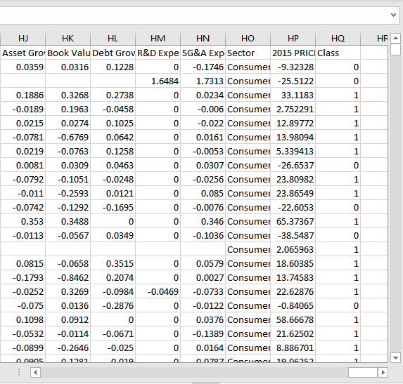
Notes:
We used a 50-Fold Cross Validation for Testing
50-60 features score the highest but the variance between scores is quite insignificant

Slide 5
Before Preprocessing
Basic Imputation
One-hot Encoding
Notes:
Removed Variables with variance less than |0.1|

Slide 6
Before Preprocessing
For cv= 5.000, mean is -192480516.592
For cv= 10.000, mean is -25035066608.244
For cv= 20.000, mean is -54147159946.297
For cv= 30.000, mean is -28666577129.083
For cv= 40.000, mean is -38450797215.902
For cv= 50.000, mean is -21208697684.553
For cv= 70.000, mean is -11132006438.947
For cv= 100.000, mean is -24039503040.749
For cv= 200.000, mean is -17614185338.130
For cv= 500.000, mean is -7464612004.326
Notes:
Removed Variables with variance less than |0.1|

Slide 7

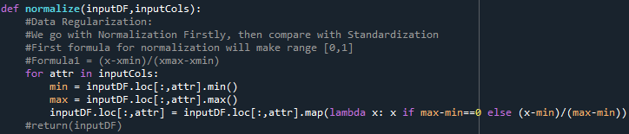
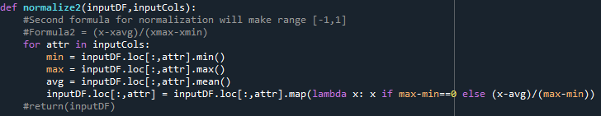
Feature Scaling
Standardization
Normalization
Log Transformations

Slide 8
Feature Scaling Results
For cv= 5.000, mean is -6757411260381922.000
For cv= 10.000, mean is -27050358245.186
For cv= 20.000, mean is -58429688981.596
For cv= 30.000, mean is -43896687246.644
For cv= 40.000, mean is -42565058618.131
For cv= 50.000, mean is -46276524432.120
For cv= 70.000, mean is -52189122493.930
For cv= 100.000, mean is -31522841124.625
For cv= 200.000, mean is -33025857331.655
For cv= 500.000, mean is -37852325418.485
Normalize1
Notes:
We decide to use both 1 and 3, as this gives us the most optimal score AND efficiently reduces dimensionality

Slide 9
Feature Scaling Results
For cv= 5.000, mean is -154174928730431424.000
For cv= 10.000, mean is -28943432437.599
For cv= 20.000, mean is -55511694727.029
For cv= 30.000, mean is -44273180812.128
For cv= 40.000, mean is -45361470906.123
For cv= 50.000, mean is -48697643977.382
For cv= 70.000, mean is -58491487962.853
For cv= 100.000, mean is -34662688990.448
For cv= 200.000, mean is -36586744246.411
For cv= 500.000, mean is -37313007206.755
(2) Normalize2
Notes:
We decide to use both 1 and 3, as this gives us the most optimal score AND efficiently reduces dimensionality

Slide 10
Feature Scaling Results
For cv= 5.000, mean is -197333639.314
For cv= 10.000, mean is -27940888004.272
For cv= 20.000, mean is -60541098265.762
For cv= 30.000, mean is -44781413817.242
For cv= 40.000, mean is -45183349718.966
For cv= 50.000, mean is -45057755511.544
For cv= 70.000, mean is -49758238986.596
For cv= 100.000, mean is -33103679358.853
For cv= 200.000, mean is -33680354749.354
For cv= 500.000, mean is -37025704414.088
For cv= 1000.000, mean is -50701271957.226
(3) Standardization
Notes:
We decide to use both 1 and 3, as this gives us the most optimal score AND efficiently reduces dimensionality

Slide 11
Additional Preprocessing
Removed Features with high Percentage of Missing Values
Removed Features with Low Correlation with Target Variable (0.1<x<-0.1)
Log Transformations

Slide 12
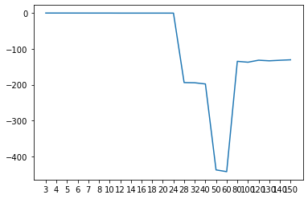
Additional Preprocessing
[-0.5510104267321101, -0.5690084582323335, -0.5782817374788073, -0.6015329023382818, -0.6156079451670707, -0.6172877526062723, -0.6345085534431991, -0.73985454690197, -0.7409099818184244, -0.7450067050793995, -0.7438626999506054, -0.7439557374788219, -0.787262998096854, -194.10353788252726, -194.64211467802426, -197.96738000735002, -437.1132242388515, -442.0217283922878, -134.96779029429828, -137.42633136483272, -131.85000351476452, -133.53320543418937, -132.01299235179403, -130.73056421980732
SelectKBest features
Log transformations

Slide 13
Hyperparameter Optimization
Grid search
Random search
Notes:
Feature Engineering already present from Checkpoint 1: Regularization and Basic One Hot Encoding, also Imputation of Missing Values

Slide 14
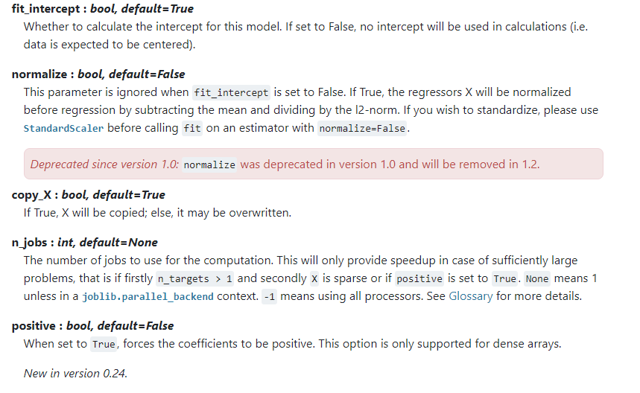
Hyperparameter Optimization
SciKit-Learn’s LinearRegression() Hyperparameters:

Slide 15
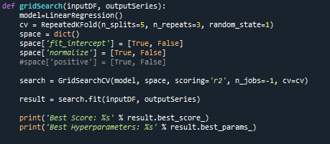
Grid Search

Slide 16
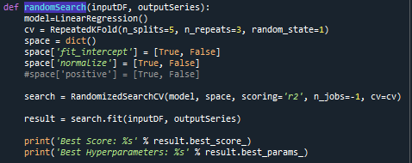
Random Search

Slide 17
Cross Sector Analysis

Slide 19
Thank you!

